Slide 1
AWS GDI
Using Grand Central and AWS to get data into Splunk
Splunk Cloud Bootcamp
May-20

Slide 2
Agenda
Setting up AWS and use Grand Central to GDI
Setup HEC on Splunk Cloud Deployment
CloudTrail, Config, VPCFlow Logs
AWS Setup
Create AWS Account
Setup VPC Flow Logs
Setup Grand Central (Local deployment)
Configure Grand Central
Deploy Data Collection
Delete Deployments

Slide 3
Splunk HEC Setup
Adding HEC Endpoints

Slide 4
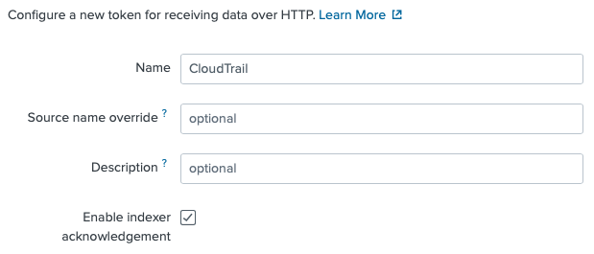
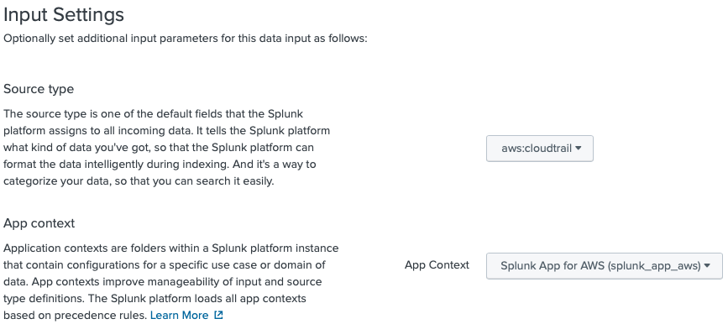
Setup HEC on Splunk Cloud Deployment
Setup CloudTrail HEC
Log into your stack and go to Settings -> Data Inputs -> HTTP Event Collector -> Add New
Step 1
Name = CloudTrail
Enable Indexer ACK = checked
Step 2
sourcetype = aws:cloudtrail
App Context = Splunk App for AWS
index=main (default)
Step 3
Submit and copy HEC Token

Slide 5
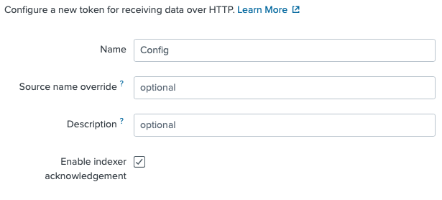
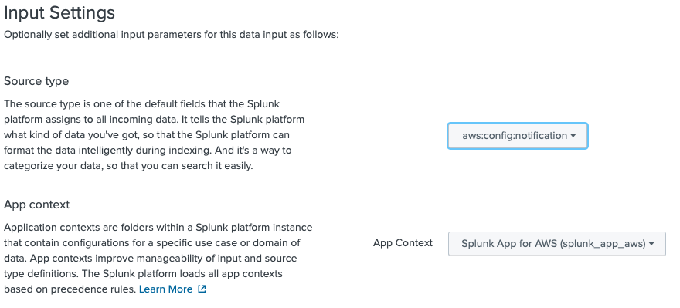
Setup HEC on Splunk Cloud Deployment
Setup Config HEC
Log into your stack and go to Settings -> Data Inputs -> HTTP Event Collector -> Add New
Step 1
Name = Config
Enable Indexer ACK = checked
Step 2
sourcetype = aws:config:notification
App Context = Splunk App for AWS
index=main (default)
Step 3
Submit and copy HEC Token

Slide 6
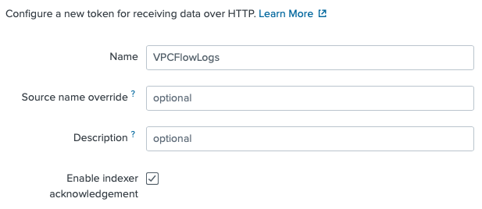
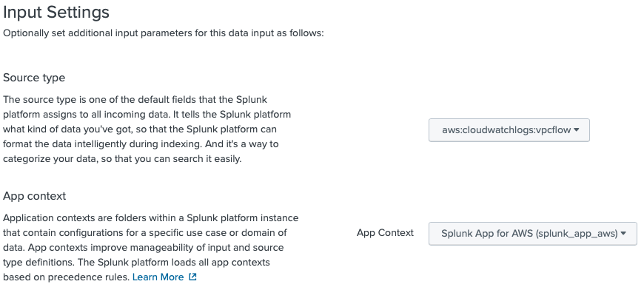
Setup HEC on Splunk Cloud Deployment
Setup VPCFlowLogs HEC
Log into your stack and go to Settings -> Data Inputs -> HTTP Event Collector -> Add New
Step 1
Name = VPCFlowlogs
Enable Indexer ACK = checked
Step 2
sourcetype = aws:cloudwatchlogs:vpcflow
App Context = Splunk App for AWS
index=main (default)
Step 3
Submit and copy HEC Token

Slide 7
Create AWS Account
Generate Credentials File

Slide 8
Create AWS Account (Credential File)
Log into your AWS Console
Create IAM Policy
Create IAM User and attach policy
Download Credentials (credentials.csv)

Slide 9
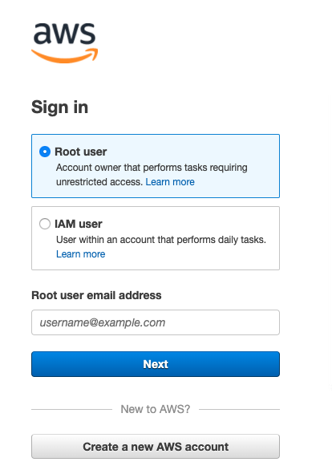
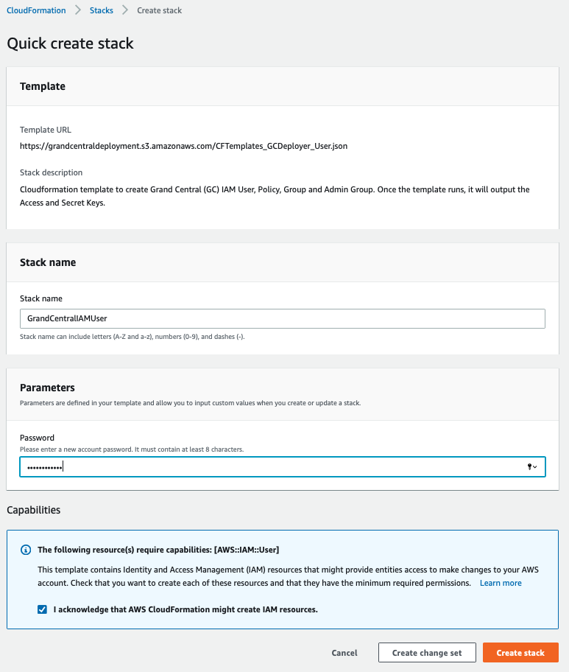
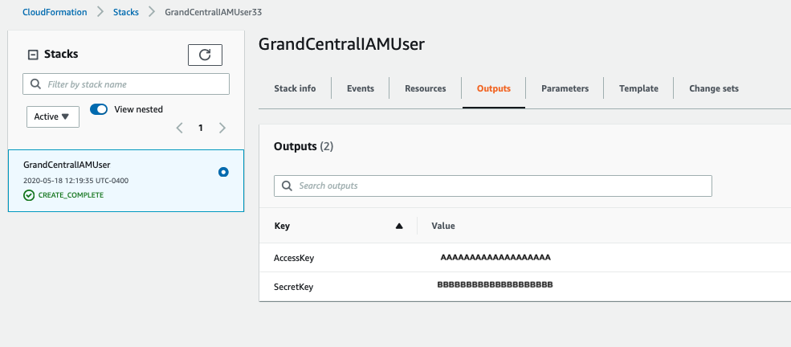
Shortcut IAM Creation
Three Step process
Log into your AWS Account
Click this link : https://go.aws/3fTEPMa
Store Credentials for next section
** See Long Form section in Appendix for step-by-step process to create IAM and Policy.

Slide 10
Setup Grand Central

Slide 11
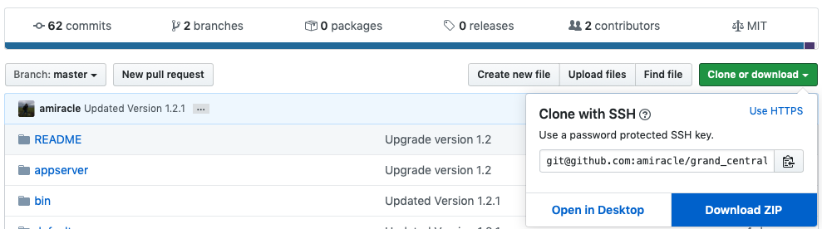
Setup Grand Central
If running locally on laptop, follow these steps:
Go to https://github.com/amiracle/grand_central and Clone or Download repo
Deploy App on your Splunk instance : $SPLUNK_HOME/etc/apps/grand_central
If you deploy using the grand_central-master.zip file, make sure to rename it to grand_central in the $SPLUNK_HOME/etc/apps directory

Slide 12
Configure Grand Central

Slide 13
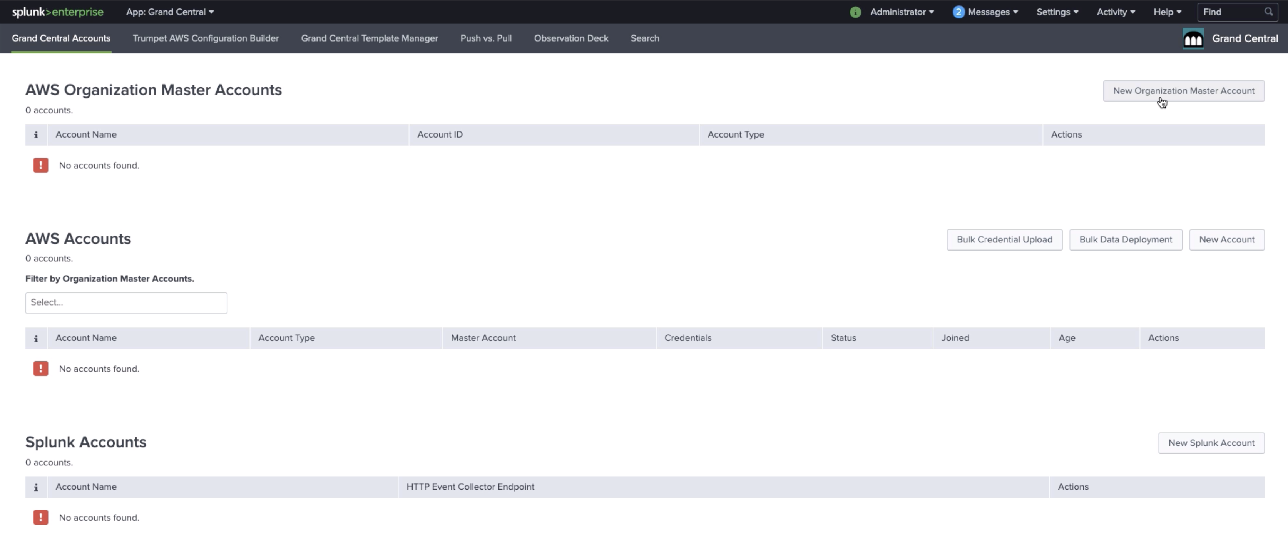
Configure Grand Central
Setup AWS Credentials 1 of 2
Click on New Account

Slide 14
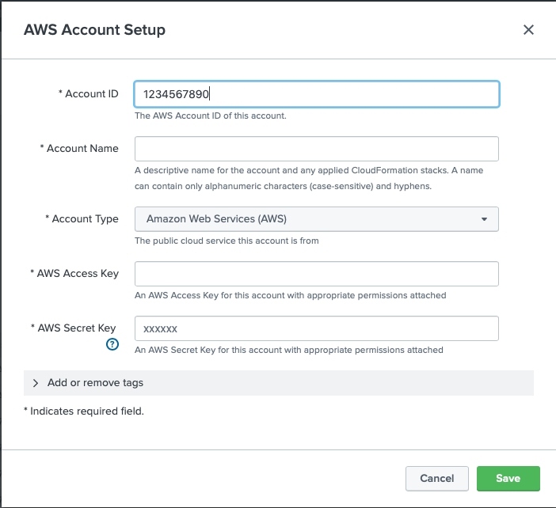
Configure Grand Central
Setup AWS Credentials 2 of 2
Enter AWS Account ID (Must me a number)
Account Name (Can be anything)
Add Access Key and Secret Key from credentials.csv file
Click Save

Slide 15
Configure Grand Central
Setup Splunk Account 1 of 2
Click on New Splunk Account

Slide 16
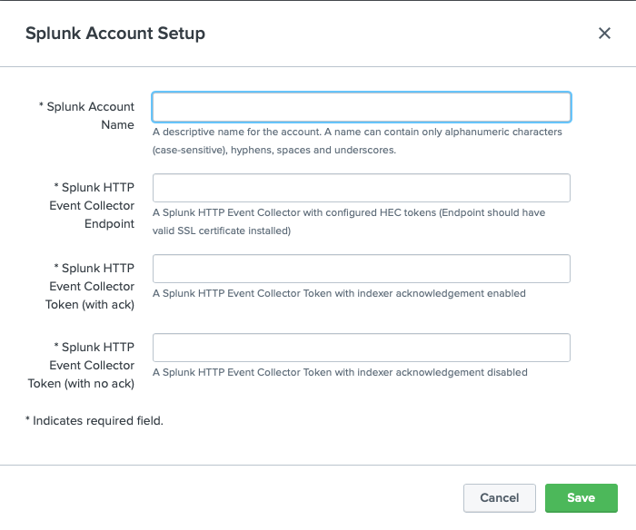
Configure Grand Central
Setup Splunk Account 2 of 2
Splunk Account Name (Can be anything)
HTTP Endpoint must include port at the end:
https://http-inputs-firehose-<bootcamp>.stg.splunkcloud.com:443
For production accounts the URL is :
https://http-inputs-firehose-<customer>.splunkcloud.com:443
Token for ACK and w/o ACK. (If only have on token, put in both spots).
Click Save

Slide 17
Deploy Data Collection

Slide 18
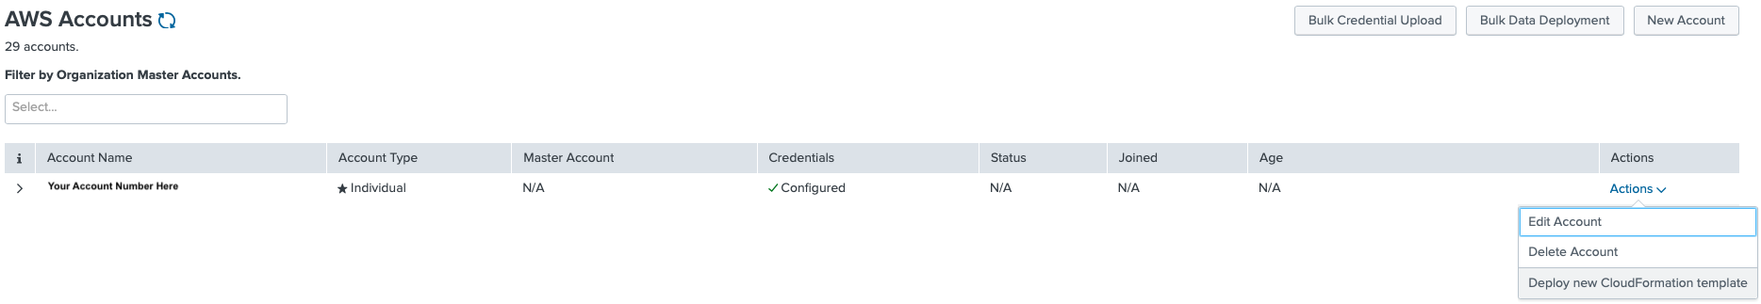
Deploy Data Collection
Rinse repeat for each sourcetype 1 of 5
Select Actions and Deploy new CloudFormation Template

Slide 19
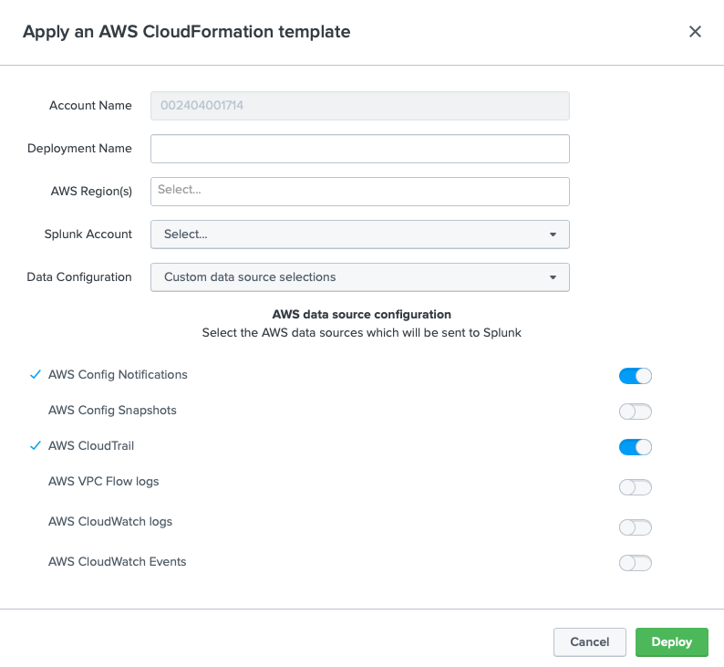
Deploy Data Collection
Rinse repeat for each sourcetype 2 of 5
Deploy Name – No spaces or special characters (e.g. grandcentralCloudTrailDeployment)
AWS Region(s) – Select regions where you have a workload (e.g. us-east-1)
Splunk Account – Send to the appropriate endpoint
Data Configuration (ignore)
Select Data source - CloudTrail

Slide 20
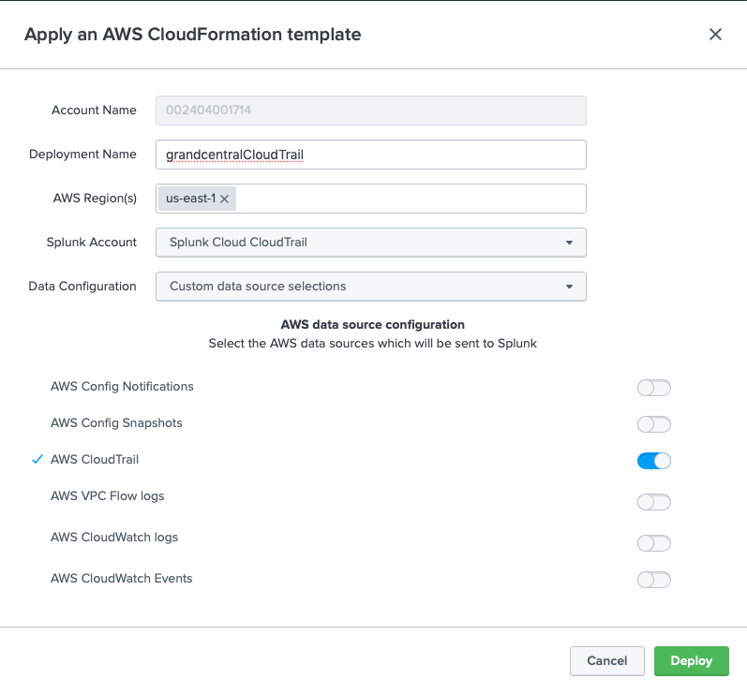
Deploy Data Collection
Rinse repeat for each sourcetype 3 of 5
Deploy Name – No spaces or special characters (e.g. grandcentralCloudTrail)
AWS Region(s) – Select regions where you have a workload (e.g. us-east-1)
Splunk Account – Send to the appropriate endpoint
Data Configuration (ignore)
Select Data source - CloudTrail

Slide 21
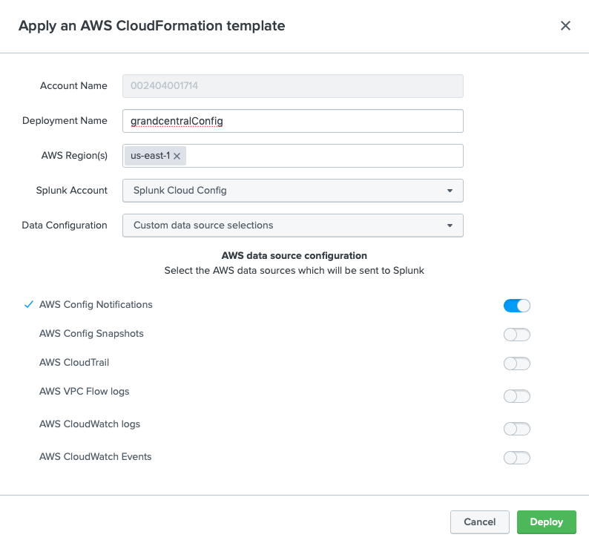
Deploy Data Collection
Rinse repeat for each sourcetype 4 of 5
Deploy Name – No spaces or special characters (e.g. grandcentralConfig)
AWS Region(s) – Select regions where you have a workload (e.g. us-east-1)
Splunk Account – Send to the appropriate endpoint
Data Configuration (ignore)
Select Data source - Config

Slide 22
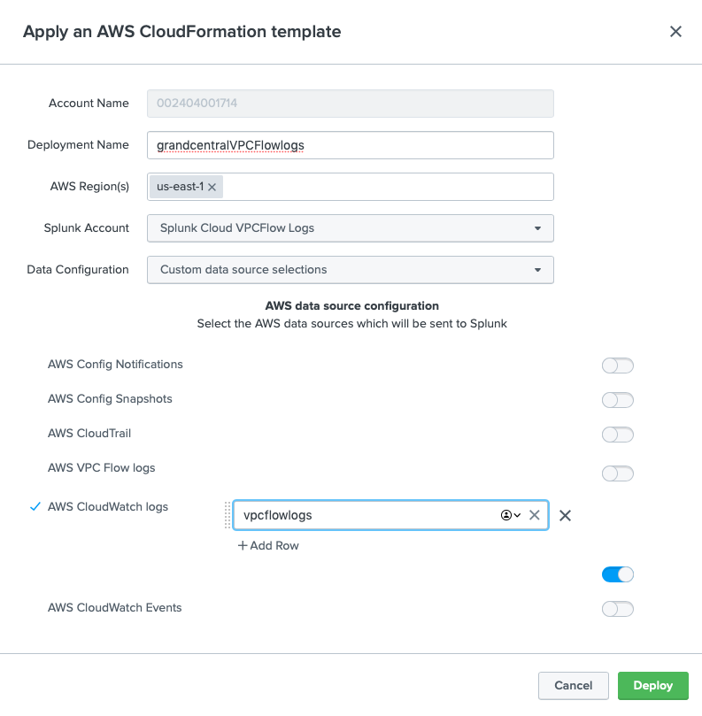
Deploy Data Collection
Rinse repeat for each sourcetype 5 of 5
Deploy Name – No spaces or special characters (e.g. grandcentralVPCFlowlogs)
AWS Region(s) – Select regions where you have a workload (e.g. us-east-1)
Splunk Account – Send to the appropriate endpoint
Data Configuration (ignore)
Select Data source – AWS VPC Flow logs
CloudWatch Log Group : vpcflowlogs

Slide 23
CloudWatch Logs Collection
This will require you to setup CloudWatch Logs and VPC Flow log collection in your account.

Slide 24
Setup AWS to send CloudWatch Log
Overview
Create CloudWatch Log Group
Setup VPCFlow Logs
Send VPCFlow Logs to CloudWatch Log group (vpcflowlogs)
Setup policy that allows VPC to write to CW Logs

Slide 25
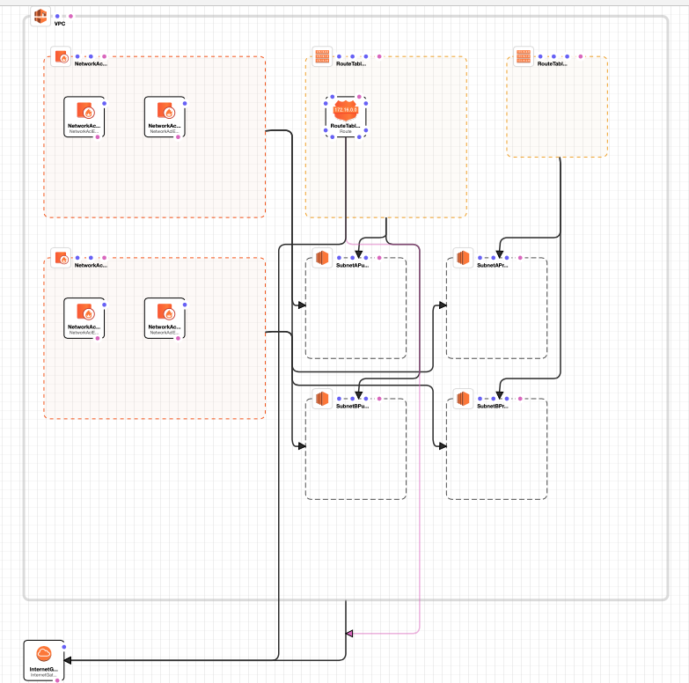
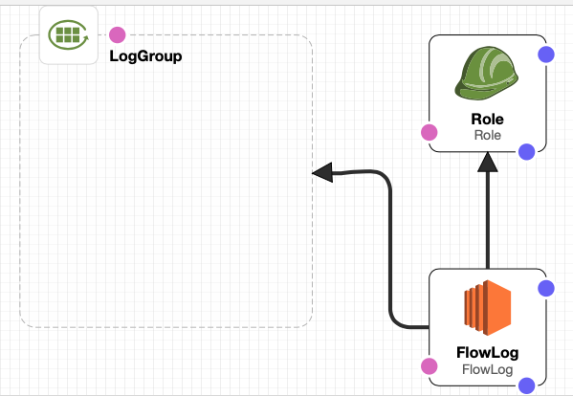
Shortcut Creating VPC & VPC Flow Logs
Use these Cloudformation templates*
Click Step 1 – VPC Creation (3 minutes)
Basic VPC created with Class B network address
Click Step 2 – Create Flow Logs (2 minutes)
Check the “I acknowledge ..” Message
Creates Flow Logs Group
Creates Flow Logs IAM Role
*Source : https://templates.cloudonaut.io/en/v3.2.1/vpc/#vpc-flow-logs-to-cloudwatch-logs

Slide 26
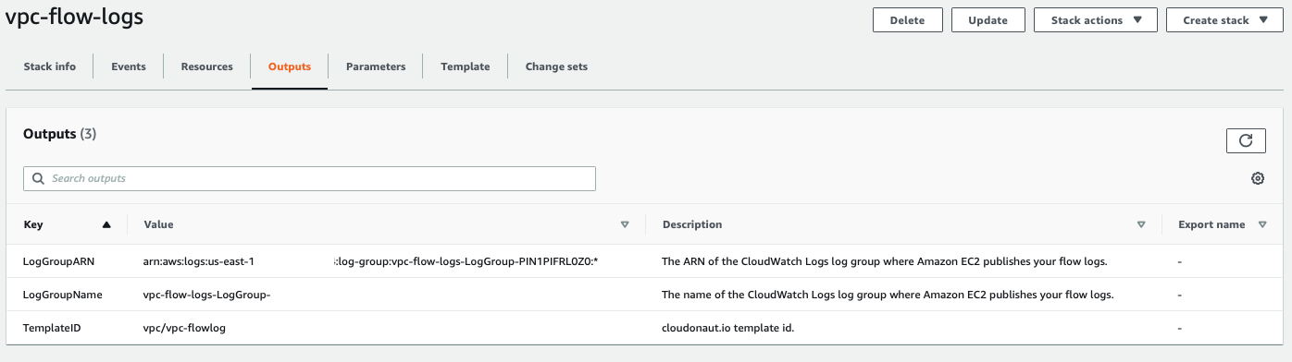
CloudWatch Log output
Copy the LogGroupName for Grand Central

Slide 27
Delete Deployments

Slide 28
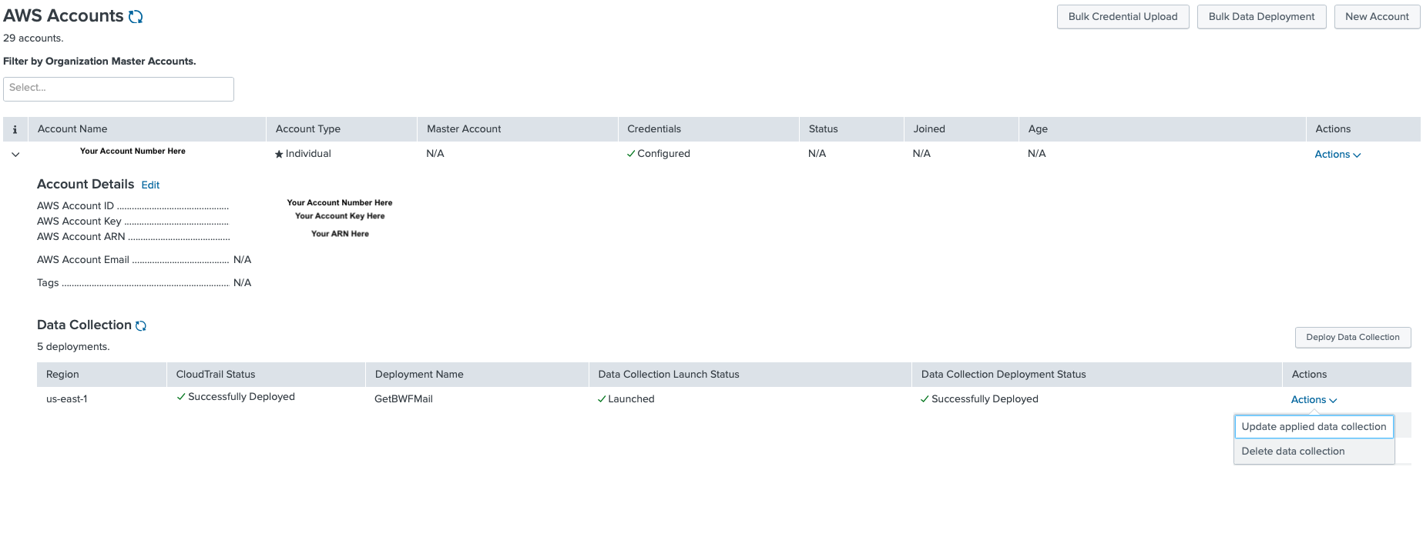
Delete Deployments
Don’t forget to remove your deployment
Click Here
to expand
Account
Click here and select Delete data collection.

Slide 29
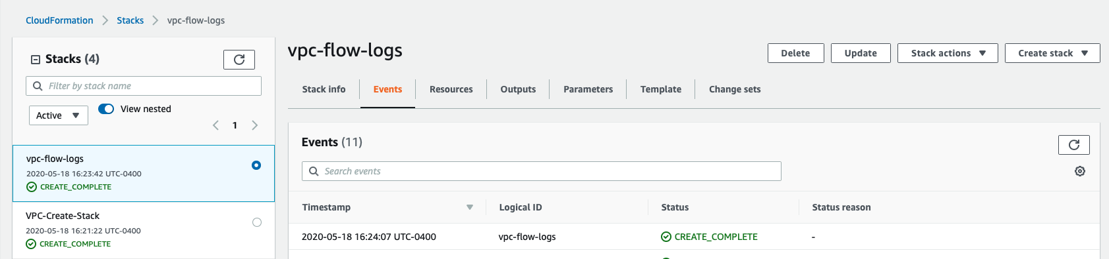
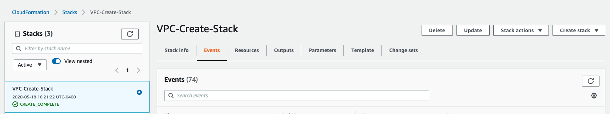
Burn Down
Here is how to burn down your VPC
Click Delete to your vpc-flow-logs Stack
Click Delete to your VPC-Create-Stack

Slide 31
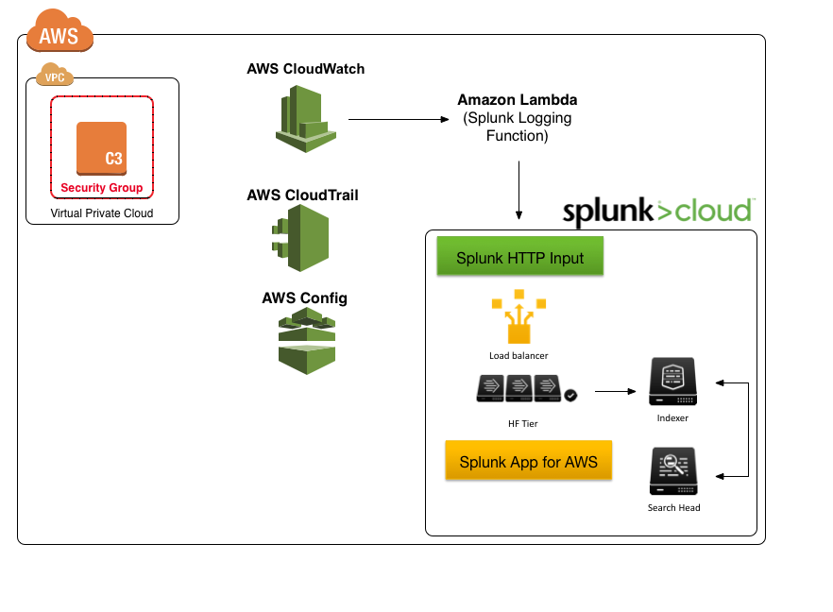
Setup AWS CloudWatch Logs
Setup VPC Flow Logs
Create CloudWatch Log Group (VPCFlowLogs)
Setup IAM User / Role VPC Flow permissions
Create VPC Flow Logs
Capture all data, no filter
Create flowlogRole policy
Notes:
Setting up CloudWatch Logs will start by creating the CloudWatch Log group, then opening the VPC service and pointing the Flow Logs to the newly created CloudWatch Log group. This will require that an IAM role be created that has access to write VPC Flow data to the CloudWatch Log Group. In the next module, we will setup a Lambda function to send the data into Splunk’s HTTP Event Collector (HEC).

Slide 32
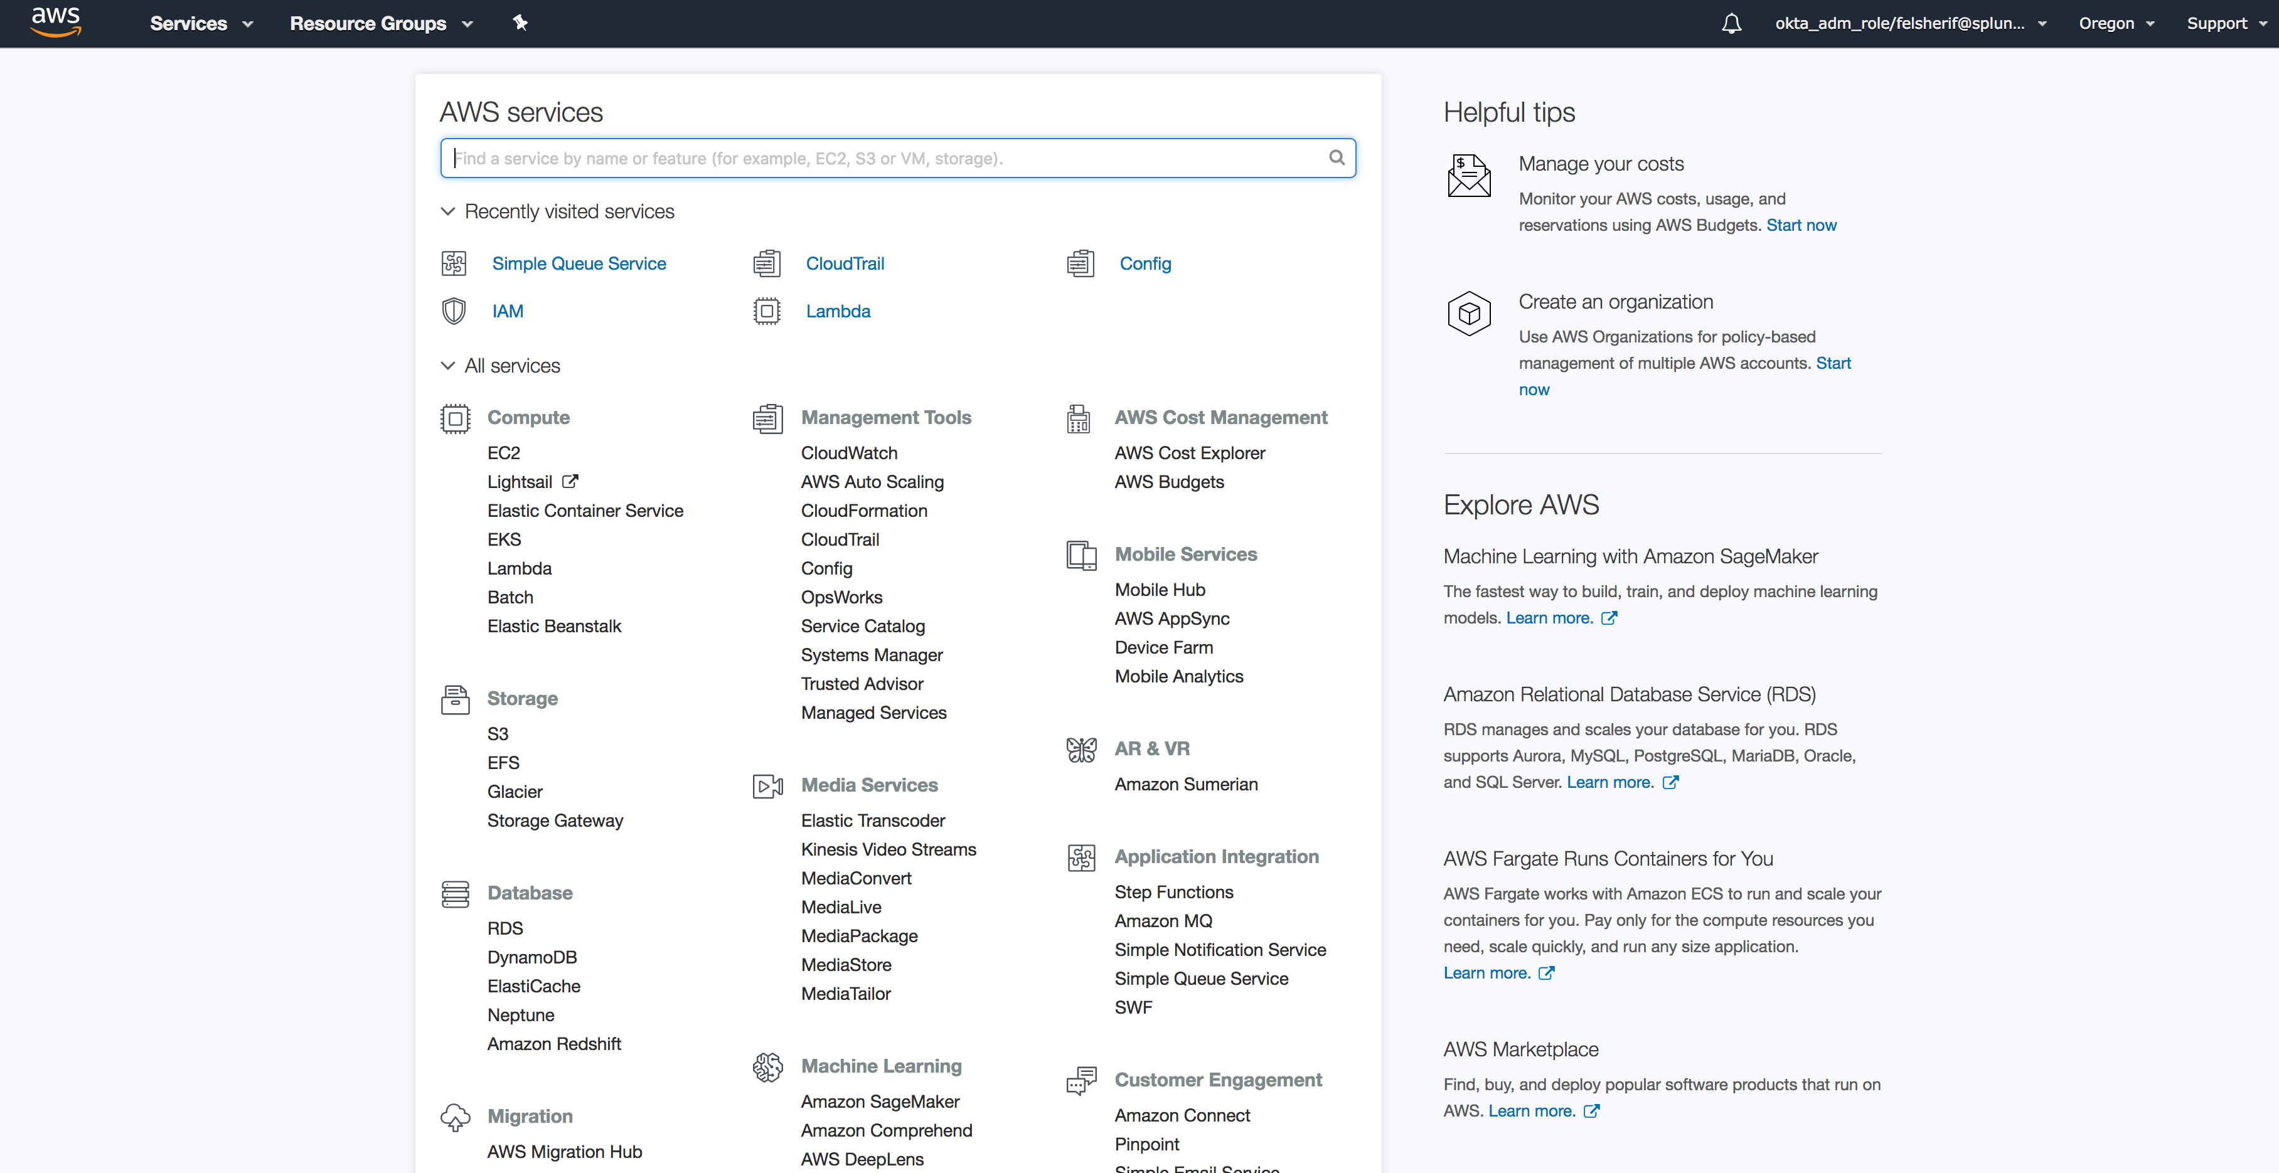
Setup AWS CloudWatch
Management Tools -> CloudWatch
Click Here
Notes:
Click on CloudWatch.

Slide 33
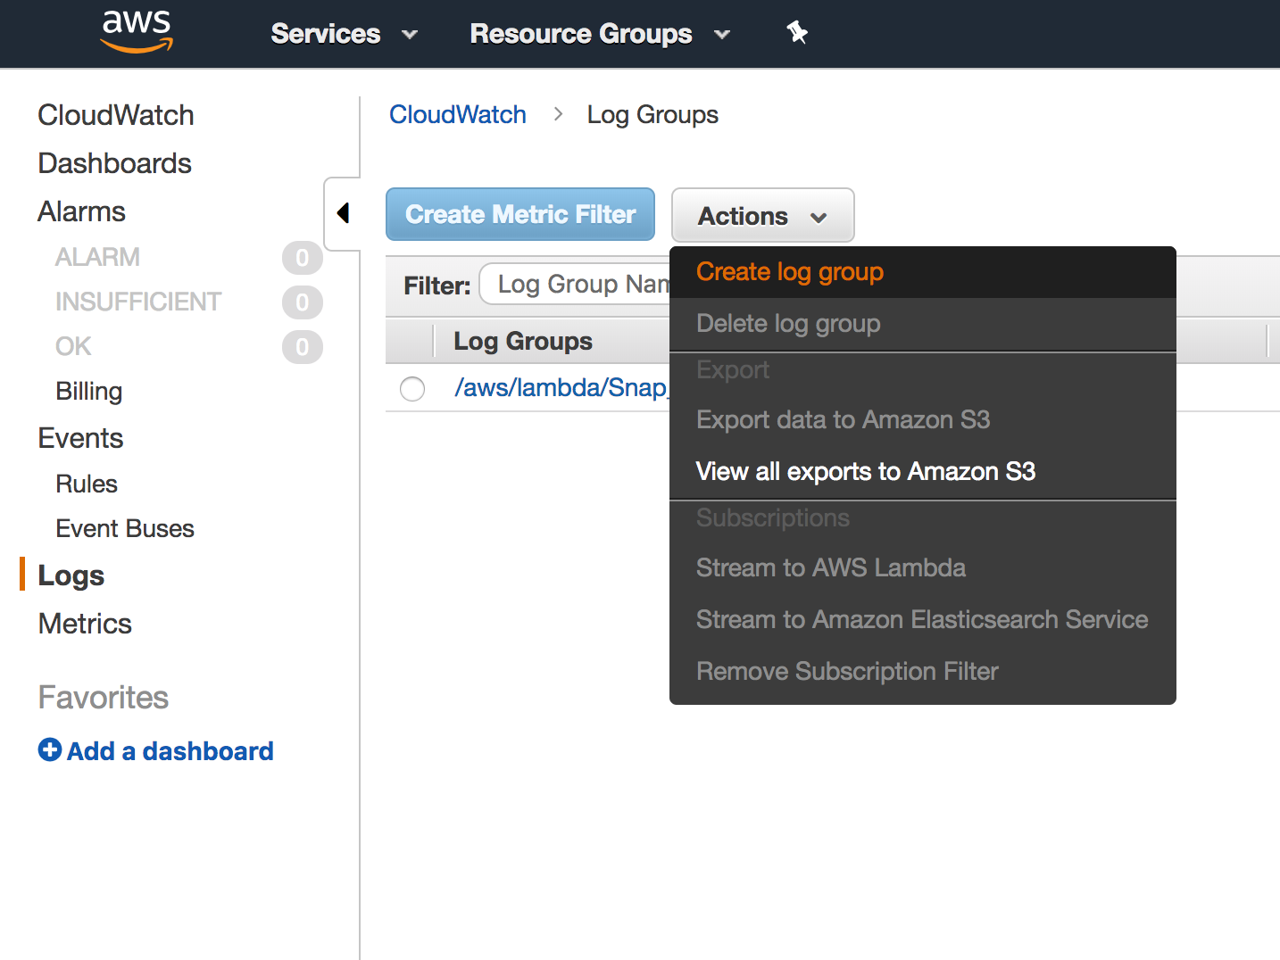
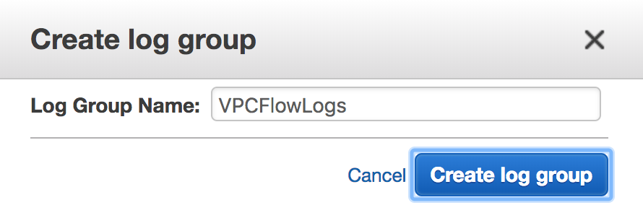
AWS CloudWatch Logs Setup
Create CloudWatch Log Group (VPCFlowLogs)
Notes:
Navigate to the Logs section on the left hand side. Click on Actions and “Create log group.” Give that log group a name, I suggest “VPCFlowLogs.”

Slide 34
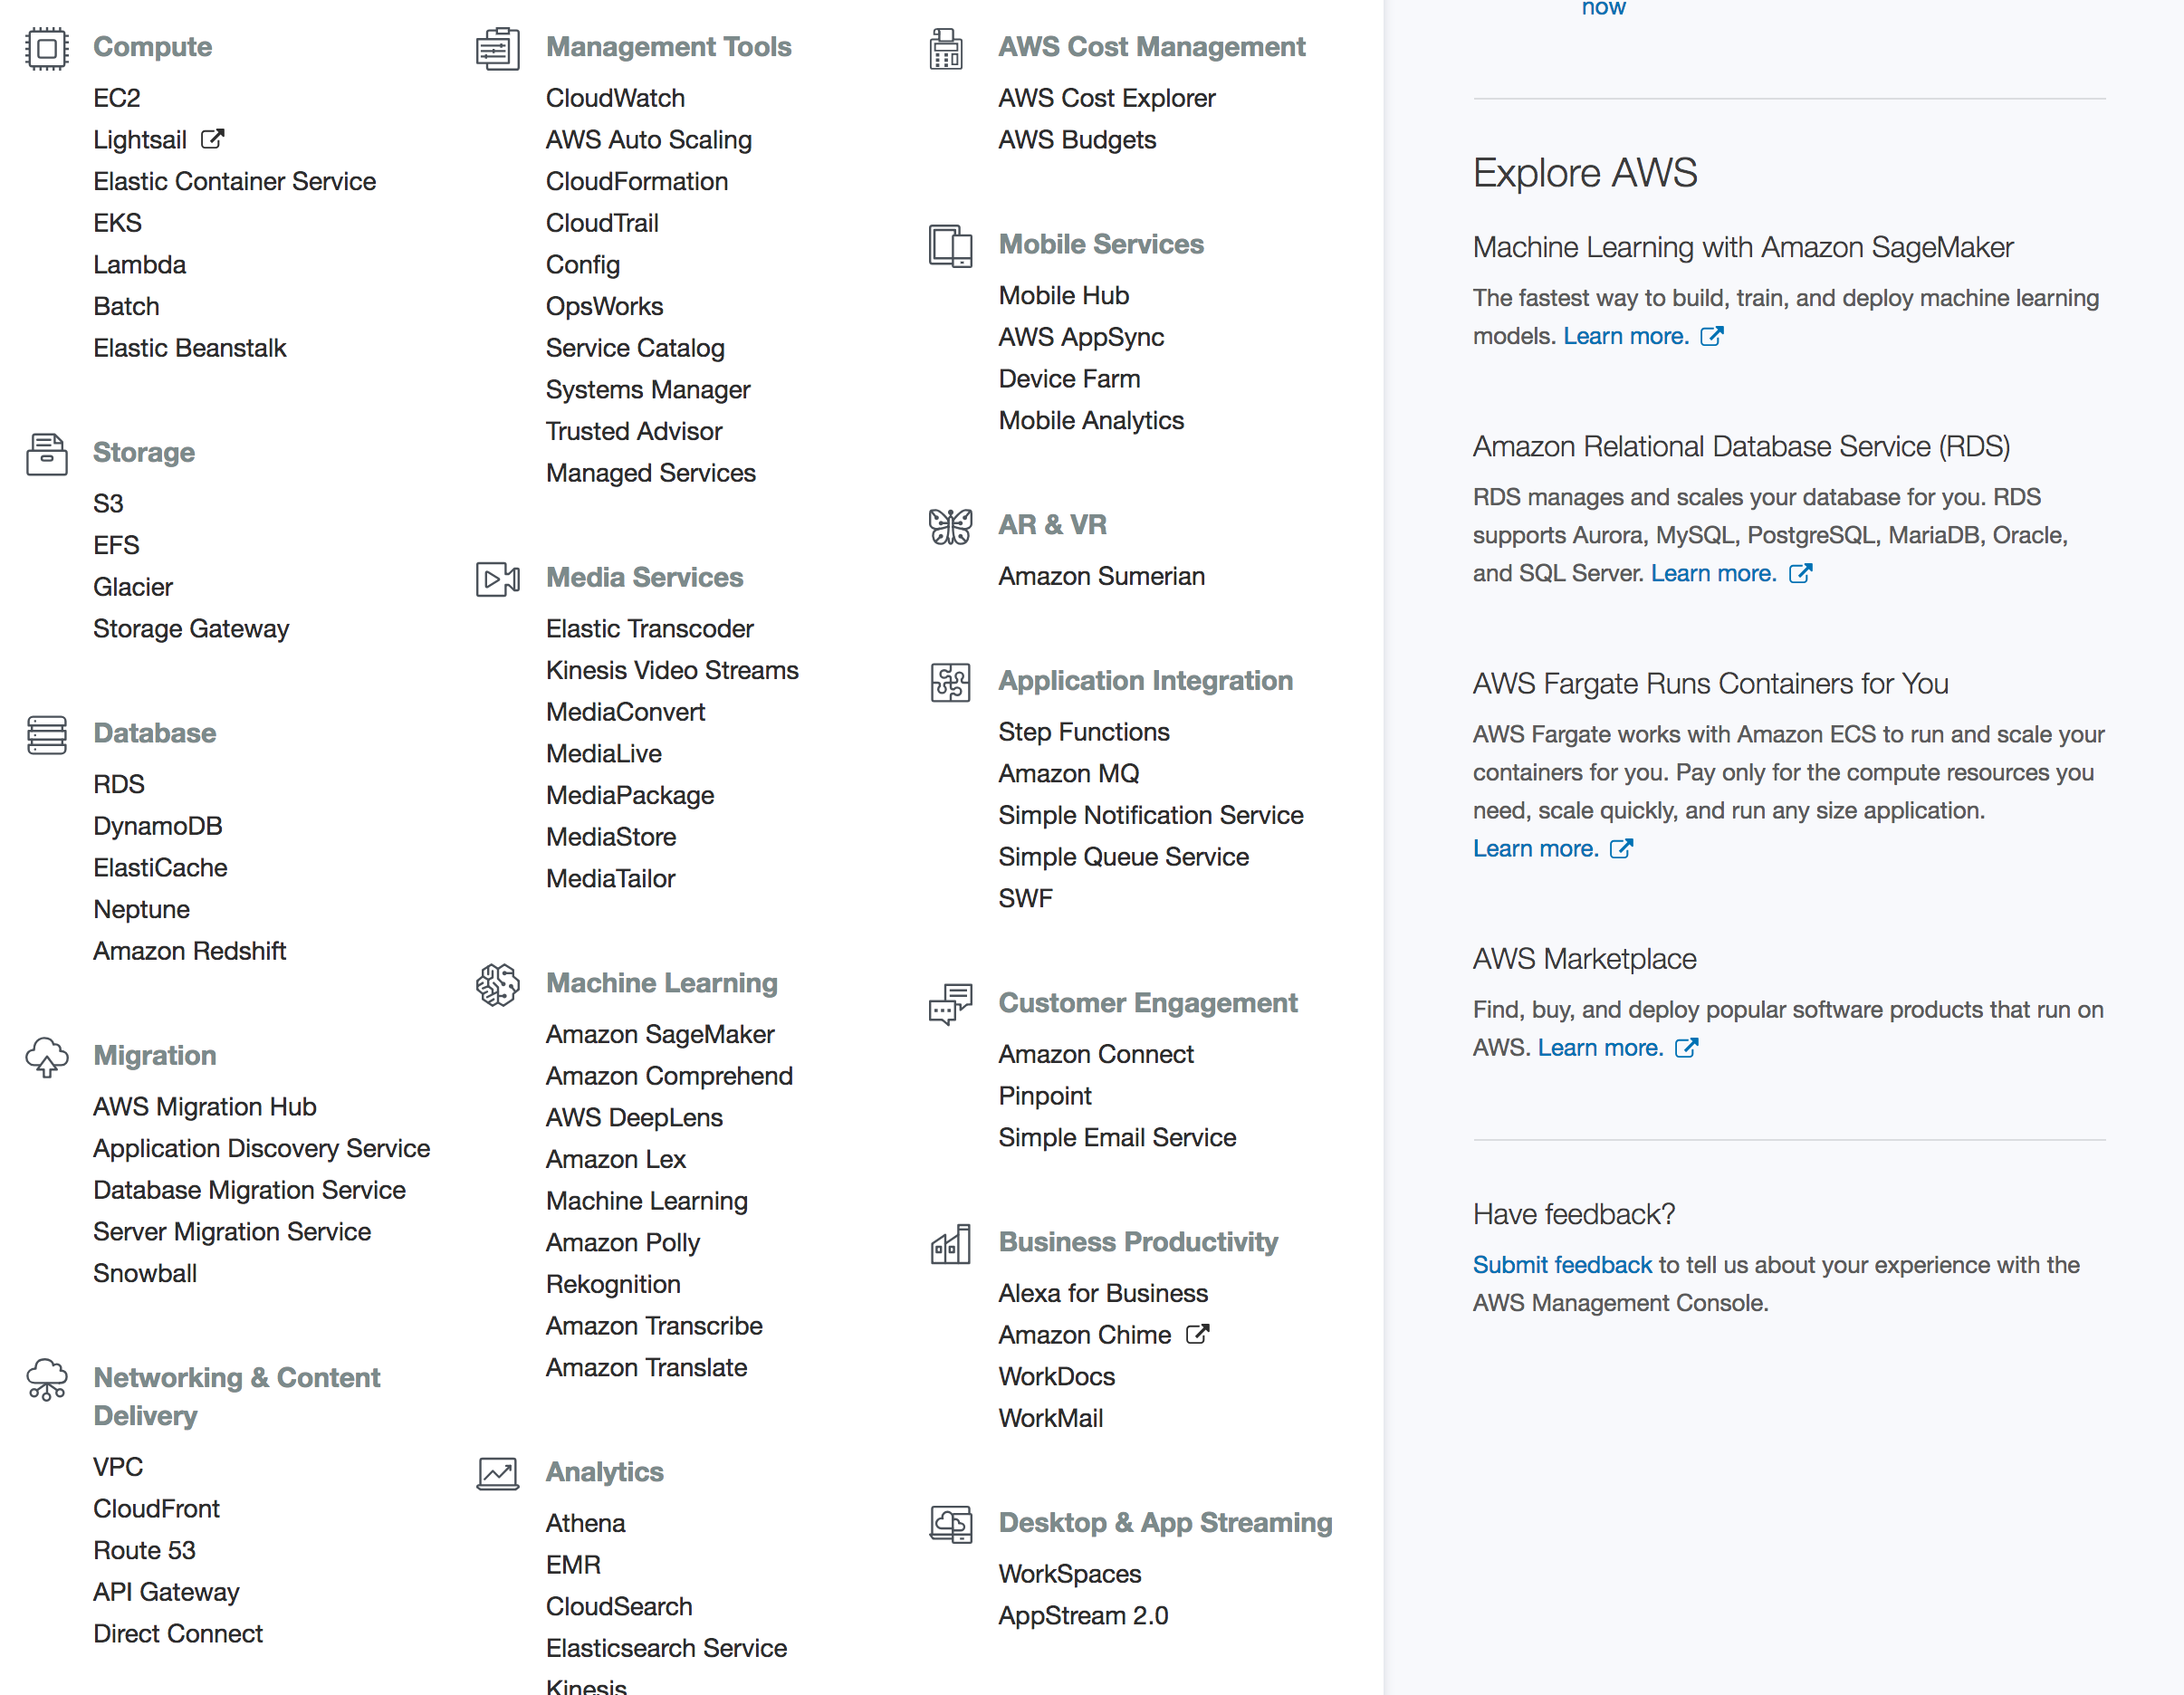
Go to the VPC Dashboard
Click Here
Notes:
Now, let’s go into VPC and enable the Flow logs to send data to that CloudWatch Log group. Click on VPC under Networking and Content Delivery.

Slide 35
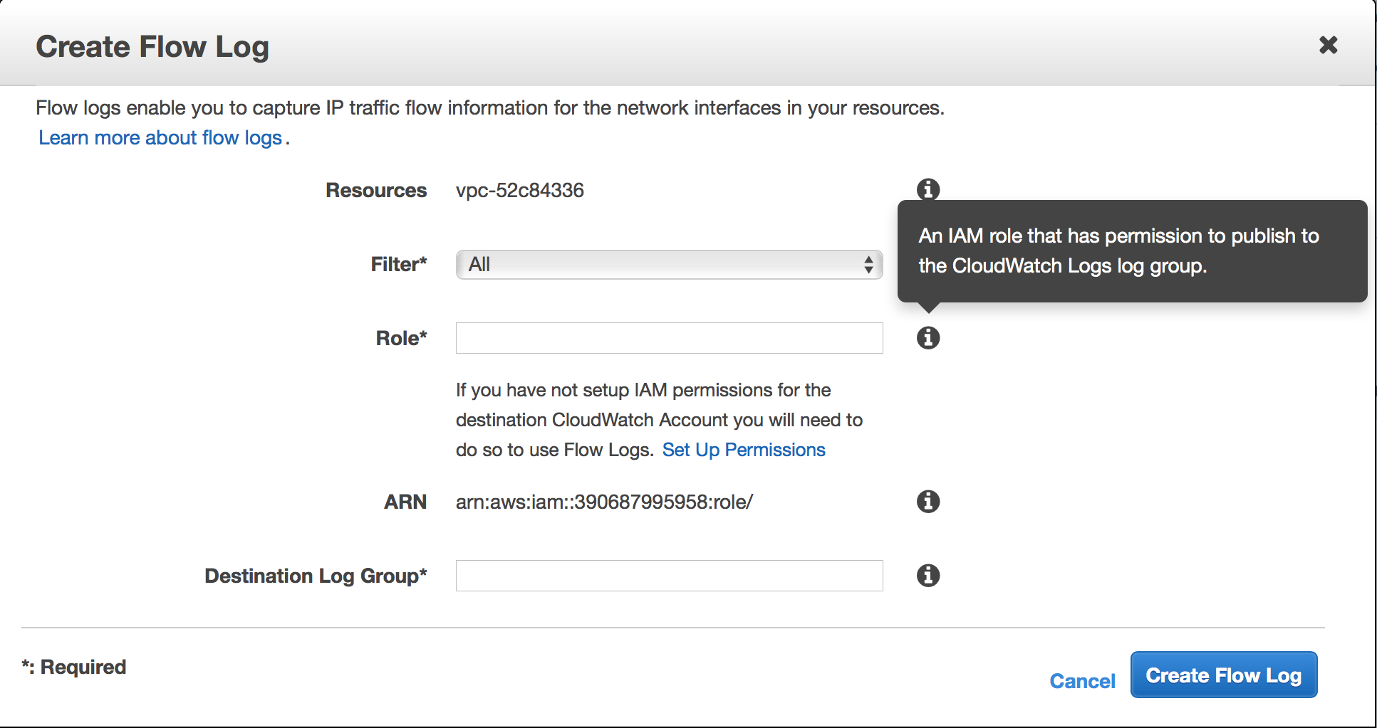
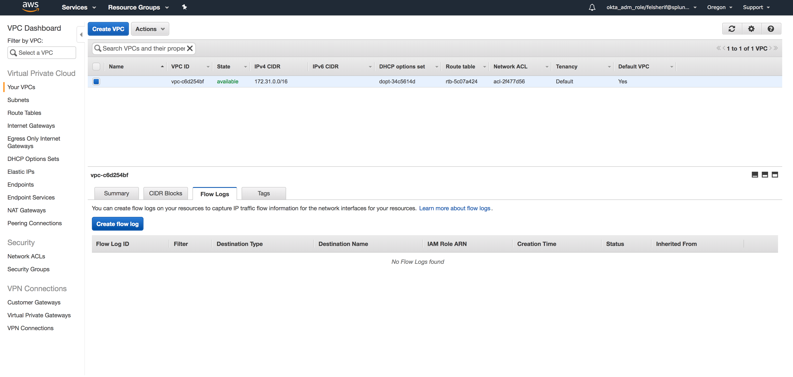
AWS CloudWatch Logs Setup
Select your VPC
Create VPC Flog Logs
Click Here
Click on “Set Up Permissions”
Notes:
Select your VPC, if you have multiple, just follow this step for each one. Once you have your VPC Selected, click on the “Flow Logs” tab and click “Create Flow Log.” This will prompt a wizard for setting up your VPC Flow logs. Under filter, select All. Now, continue to the next slide, DO NOT CLICK on Create Flow Log yet!

Slide 36
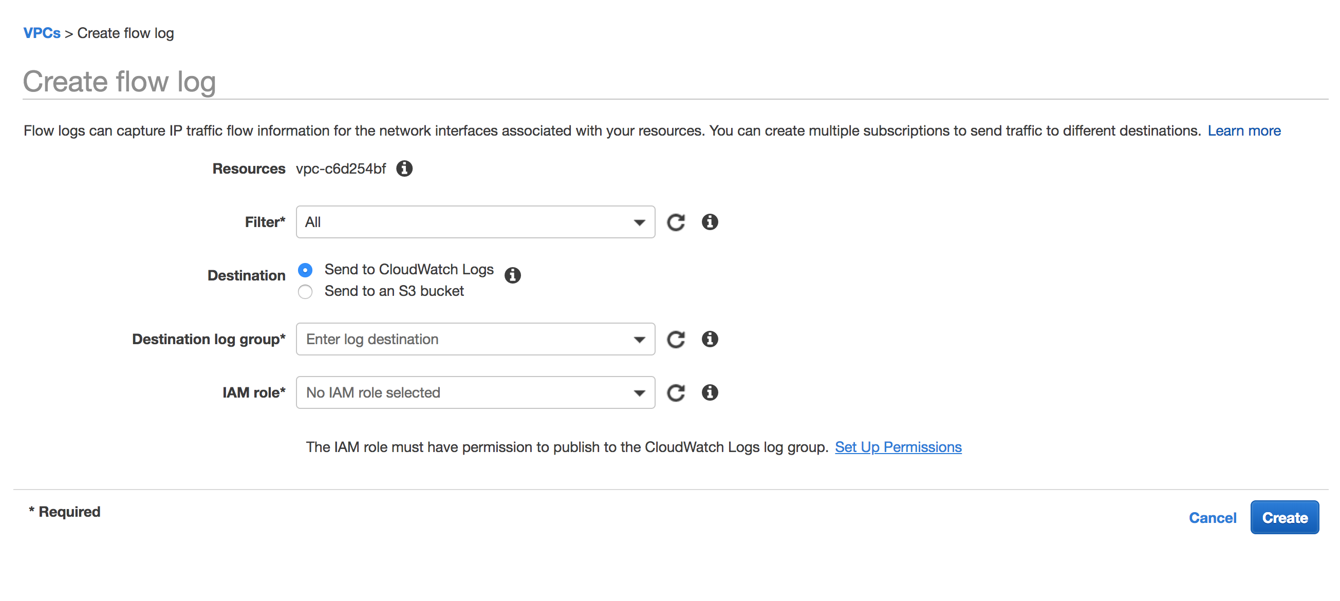
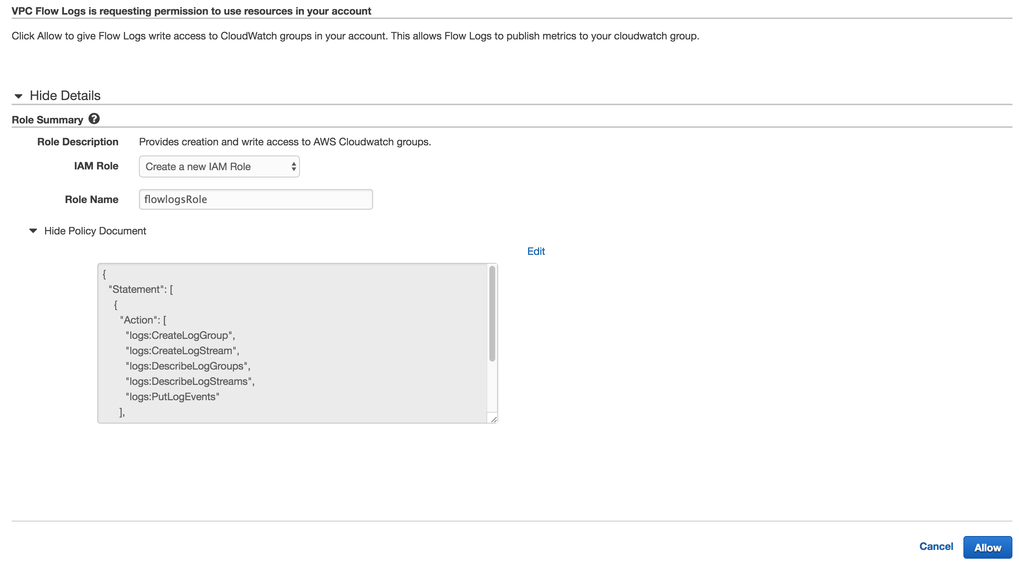
AWS CloudWatch Logs Setup
Create the default policy ‘flowlogsRole’
Click on “Set Up Permissions” and create default VPC Flow Role “flowlogsRole”
The Policy editor will pop-up, click allow and it will create the default role “flowlogsRole” and click Allow
Notes:
If this is the first time you are creating a VPC Flow Log, make sure you click on “Set Up Permissions,” since you probably DO NOT have a role to collect the VPC Flow data. This will go to a new tab where a new role ‘flowlogsRole’ will be automatically created. Click on Allow a the bottom right hand side of the screen. Continue to the next slide.

Slide 37
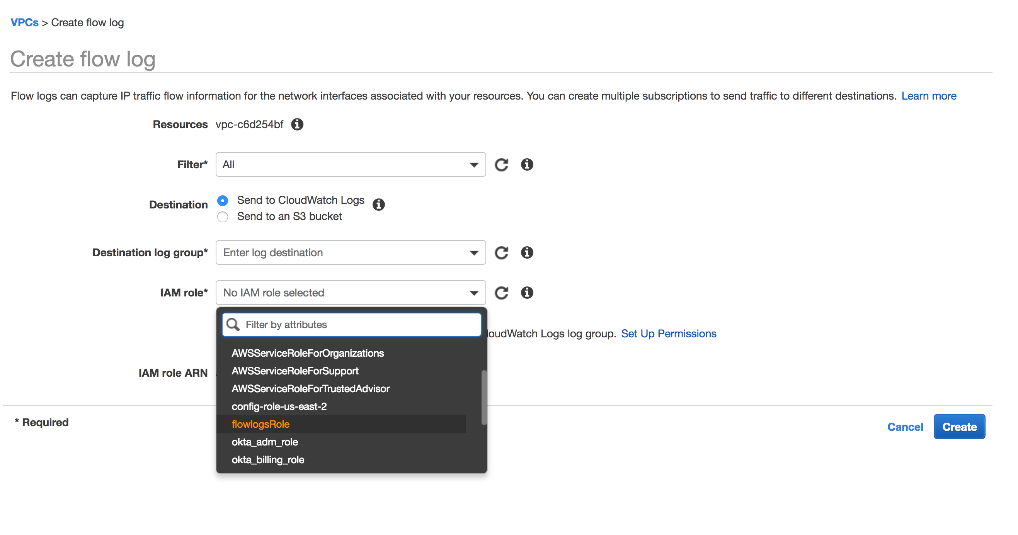
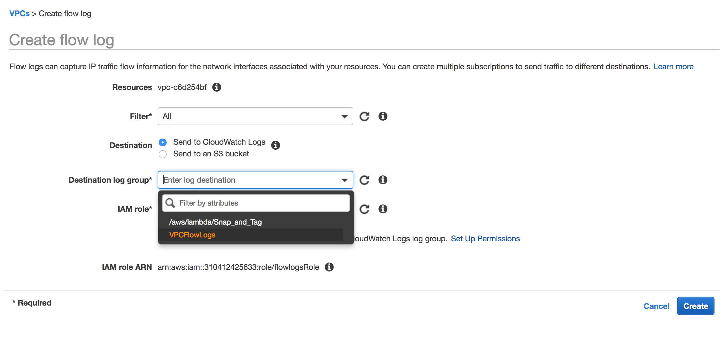
AWS CloudWatch Logs Setup
Select CloudWatch Log Group, VPCFlowLogs
Select “flowlogsRole”
Select the CloudWatch Log group VPCFlowLogs.
Click Create Flow Log
Notes:
You should now see the newly created role, flowlogsRole, in the dropdown; select that role and then select the Destination Log Group VPCFlowLogs (the one we just created in the CloudWatch Logs step.) Now click on “Create Flow Log.”

Slide 38
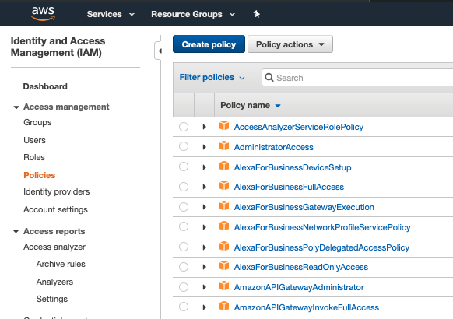
Create AWS Account (Credential File)
AWS Console - > IAM -> Create Policy
Create Policy
Go to IAM
Click on Policies
Click Create Policy

Slide 39
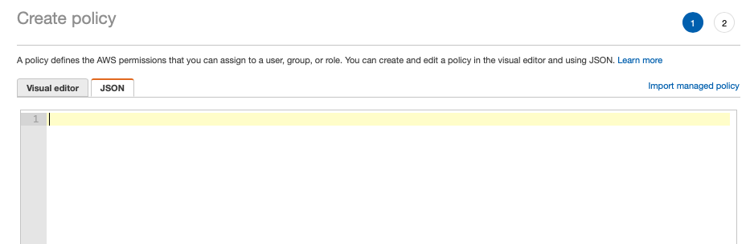
Create AWS Account (Credential File)
AWS Console - > Create Policy (JSON)
Click on the JSON tab
Clear out all the existing policy

Slide 40
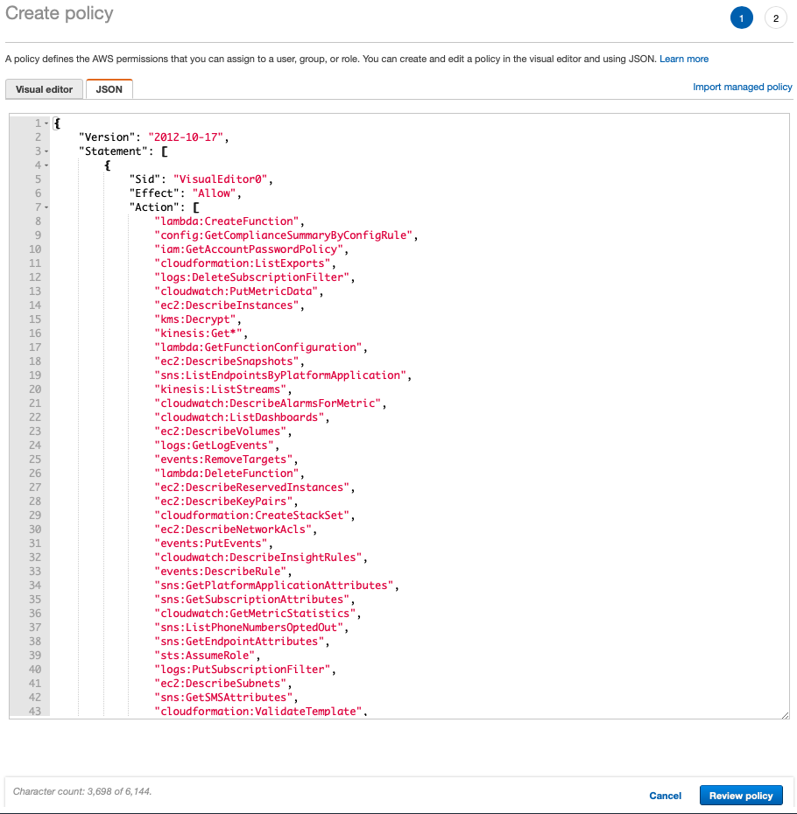
Create AWS Account (Credential File)
AWS Console - > Create Policy (JSON)
Copy the policy from here
Paste the policy here
Click Review Policy

Slide 41
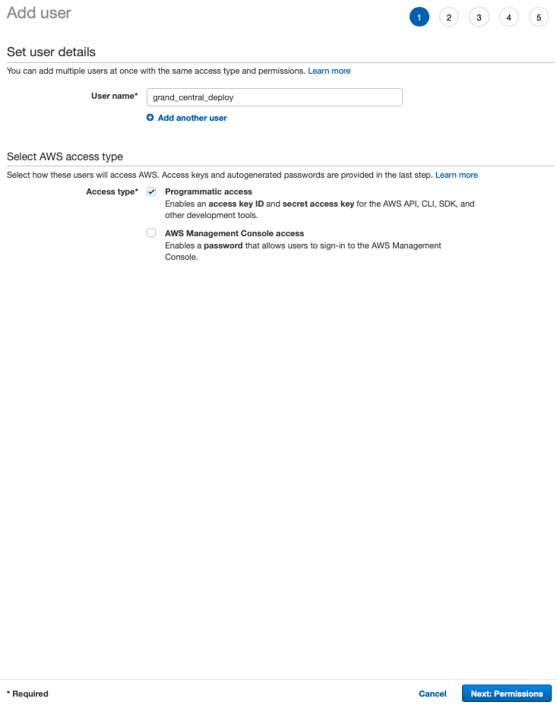
Create AWS Account (Credential File)
AWS Console - > Create User
Create User : grand_central_deploy
Programmatic access checked
Click Next : Permissions

Slide 42
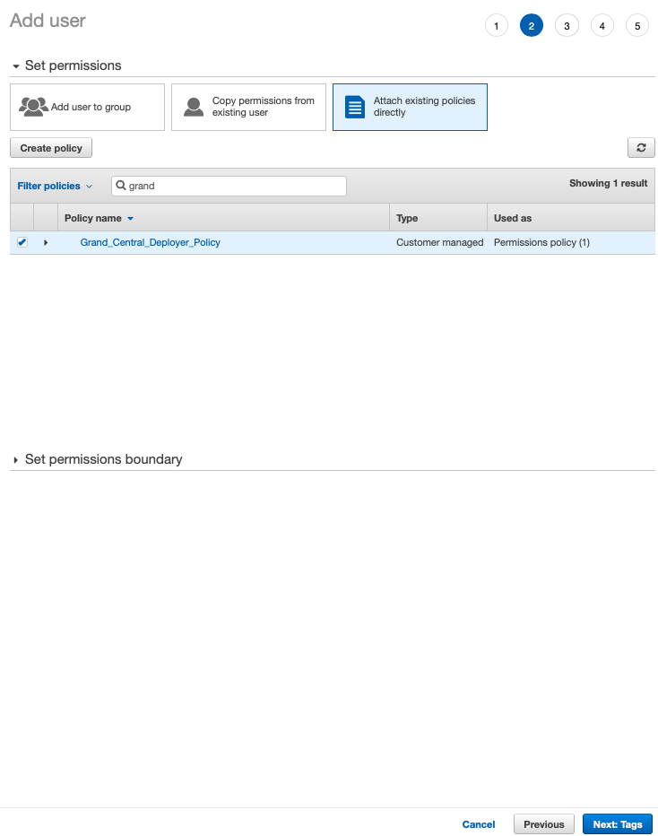
Create AWS Account (Credential File)
AWS Console - > Set Permissions
Select Attach policies directly
Search for “Grand_Central…” policy
Click the check box
Click Next : Tags

Slide 43
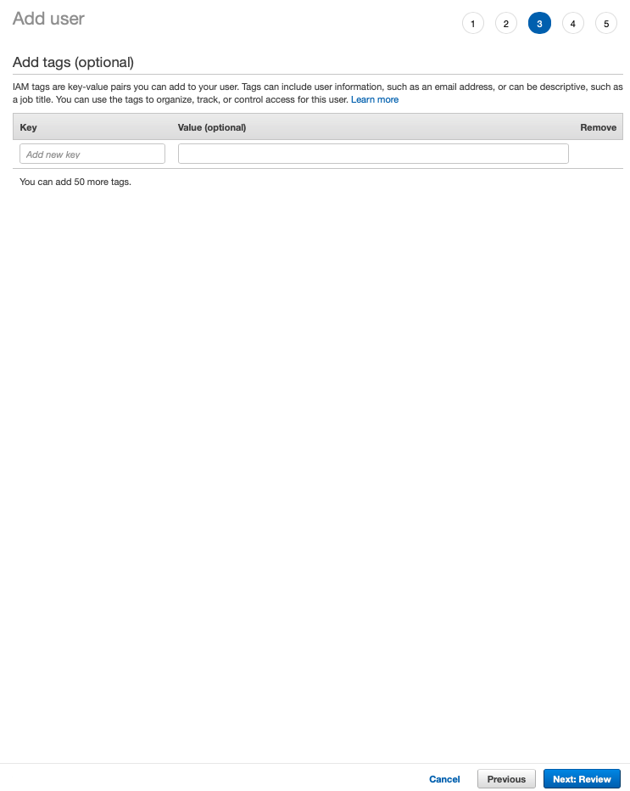
Create AWS Account (Credential File)
AWS Console - > Skip Tags
Skip adding tags
Click Next : Review

Slide 44
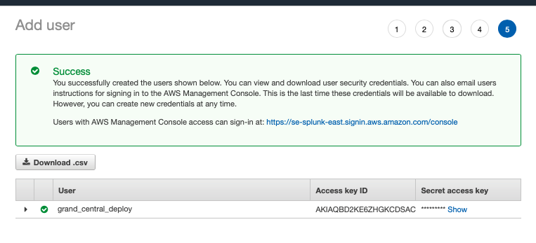
Create AWS Account (Credential File)
AWS Console - > Review
Click Download .csv
Save the credentials.csv

